Slide 1
The Voice of Experience:
The Impact of Individual and Group Attributes
on Talker-Specific Adaptation in Speech
Lynne C. Nygaard
Department of Psychology
Emory University
Workshop on Current Issues and Methods in Speaker Adaptation
The Ohio State University
April 6, 2013

Slide 2
Spoken Language and Variation
Informative and socially relevant
  talker identity, age, emotion, social status, health
Changes how words are realized in the acoustic speech signal
    bug, bug, bug, bug, bug, bug
Problem: How do listeners contend with the enormous amount of variability in speech?

Slide 3
Theoretical approaches
• Abstractionist
- normalization
    - linguistic representations are
    abstract and non-perceptual
• Perceptually grounded
      - instance- or exemplar-based
      (Goldinger, 1998; Johnson, 1997, 2006; Pierrehumbert, 2001)
- linguistic representations are perceptual

Slide 4
Spoken Language
  How do listeners use informative variation in the understanding of linguistic content?
  Is there variation in listeners’ ability to identify and accommodate to particular talkers or groups of talkers? If so, what may account for that variation?

Slide 5
Outline
  • Short-term task-related changes in attention or expectation
  - perceptual adaptation to accented speech
  - attention and structured exposure
  • Long-term differences in listeners’ sensitivity to socially relevant variation
  - vocal adaptation
  - listener-talker attunement

Slide 6
Outline
  • Short-term task-related changes in attention or expectation
  - perceptual adaptation to accented speech
  - attention and structured exposure

Slide 7
Perceptual learning of an accent category
Adult listeners perceptually adapt to systematic properties of non-native speech
(Bradlow & Bent, 2008; Clarke & Garrett, 2004; Sidaras et al, 2009)
Listeners extract accent-general properties of speech that generalize to novel utterances and novel talkers

Slide 8
Task and Attention
How does task type affect listeners’ ability to learn the systematic properties of foreign accented speech?
Do changes in attention during different tasks alter perceptual learning of spoken language?
  Within-listener changes in perceptual adaptation
  Talker-independent attributes of accented speech

Slide 9
Stimulus materials
Speakers
native Spanish speakers from Mexico City
6 female and 6 male speakers
Isolated words -
easy words (e.g., bug, main, suck)
hard words (e.g., balm, fig, teeth)

Slide 10
Accent Training Study
Listeners
• native speakers of American English • equally unfamiliar with accent used
Procedure
• Training Phase - experience with six talkers
~ 45 minutes of training
• Test Phase - Generalization
- transcription (novel words and talkers)

Slide 11
Training conditions
  Transcription
  Transcribed words and were given feedback.
  Accentedness Ratings
  Rated each utterance on a scale of 1-7
  (not accented to very accented)
  Talker Identification
  Matched names to each of the 6 talkers

Slide 12
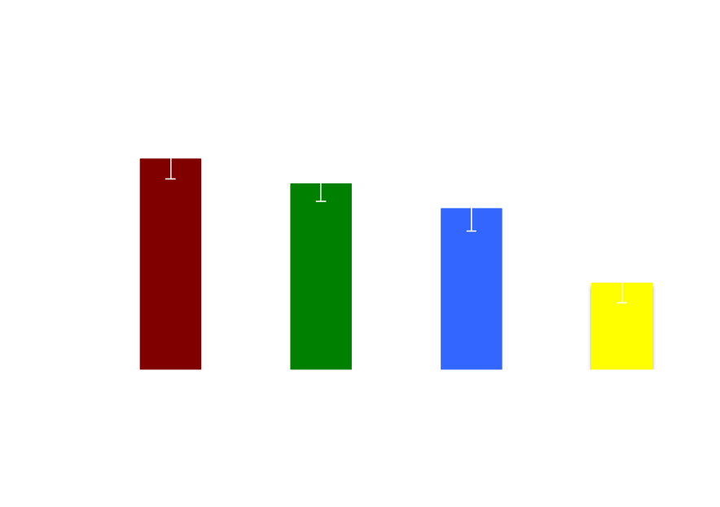
Task Types

Slide 13
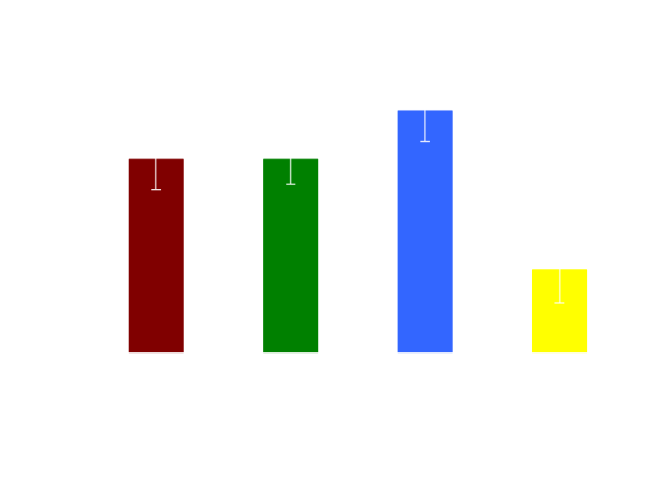
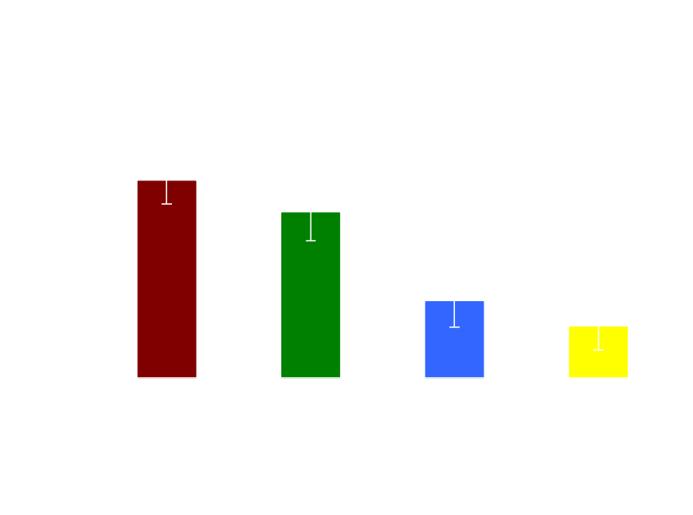
Easy Words
Hard Words

Slide 14
Task and Attention
• Differences in training focus attention on particular properties of accented speech
• Transcription and accented rating tasks may focus attention on the systematic cross-speaker variation
• Talker identification tasks may focus on surface form differences between talkers

Slide 15
Structured exposure
Does organization of training material affect perceptual adaptation?
What type of exposure, and opportunity to compare across utterances, do listeners require to learn systematic variation?

Slide 16
Structured exposure
• Variability training
mixed presentation of words and speakers
• Speaker training
blocked by speaker
• Word training
blocked by word
• No training
Notes:
Same types and tokens, but different organization

Slide 18
Structured exposure

Slide 19
Comparison and Learning
• Organization of training materials significantly influenced perceptual learning of accented speech
• High-variability stimuli appear to draw attention to accent-general properties of speech, perhaps due to comparison and alignment
(Markman & Gentner, 1993; Namy & Gentner, 2002; Sumner, 2011)

Slide 20
Outline
  • Short-term task-related changes in attention or expectation
  - perceptual adaptation to accented speech
  - attention and structured exposure
  • Long-term differences in listeners’ sensitivity to socially relevant variation
  - vocal adaptation
  - listener-talker attunement

Slide 21
Outline
  • Long-term differences in listeners’ sensitivity to socially relevant variation
  - vocal adaptation
  - listener-talker attunement

Slide 22
Individual Differences
• Individual differences in listener characteristics and experience
Gender differences in talker learning
Gender differences in vocal accommodation
Social expectations and speaker adaptation

Slide 23
Voice learning
Are there individual differences among listeners in perceptual
sensitivity to talker-specific characteristics?
gender differences in voice learning

Slide 24
Procedure
Training (days 1-3)
• 3 days of training on 10 talkers’ voice
(5 male, 5 female)
• Listeners (10 male, 10 female)
Generalization (day 4)
• 50 novel sentences
• listeners asked to identify the talkers

Slide 25
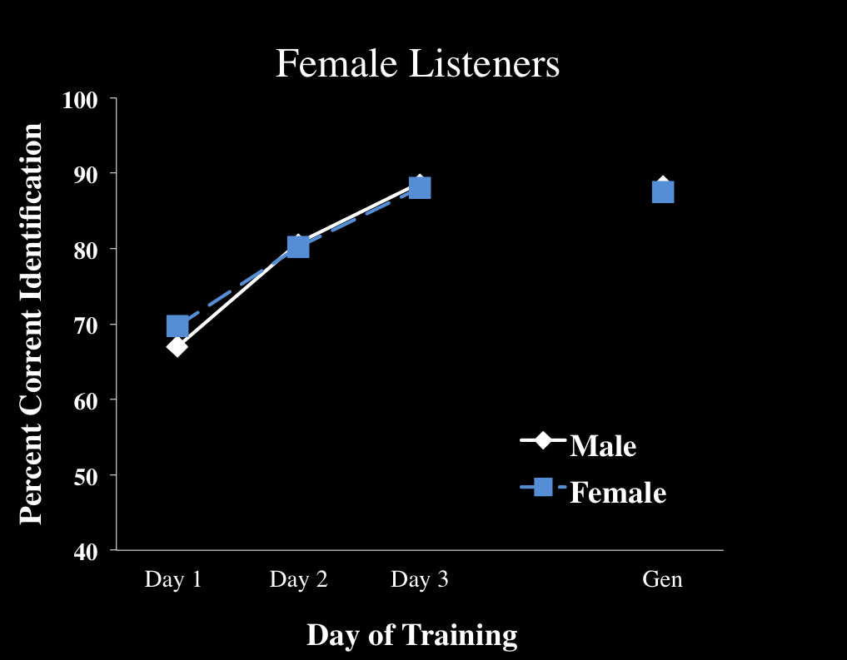

Talker Identification
Nygaard & Queen (2000)

Slide 26
Vocal accommodation
Will individual differences in sensitivity to vocal characteristics influence vocal accommodation and adaptation?

Slide 27
Shadowing Task Methodology
Speakers: 2 male and 2 female talkers
Shadowers: 8 male and 8 female talkers
Raters: 32 listeners
AXB task to index degree of accommodation
Materials: 20 low frequency bi-syllabic English words

Slide 28
Methodology
Baseline Phase:
- Read 20 items aloud
Shadowing Phase:
- Heard same 20 items produced by 4 speakers
- Asked to repeat the word aloud
Rating Phase:
- Raters presented with AXB task
Baseline (A) – Target (X) – Shadowed (B)
Notes:
Cue graph…

Slide 29
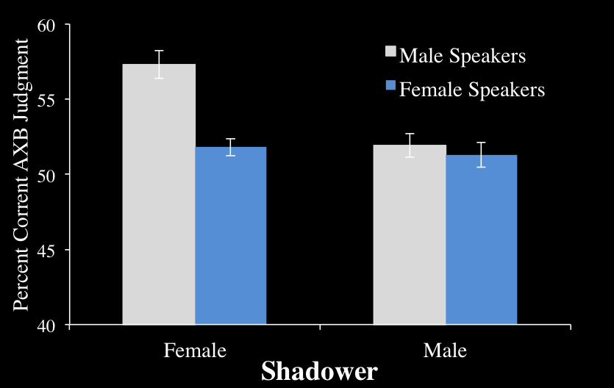
Vocal accommodation
Namy, Nygaard & Sauerteig (2002)

Slide 30
Vocal alignment and gender
Individual differences in perceptual sensitivity appeared to lead to differences in vocal adaptation
Individual differences in attention or sensitivity to indexical variation
Socially conditioned adaptation
(Babel, 2012; Johnson, 2006; Pardo, 2006)

Slide 31
Vocal alignment as a function of social expectations
How do listeners’ social attitudes and expectations influence the
degree and nature of vocal accommodation behavior?

Slide 32
Social expectations or stereotypes
  Vocal accommodation as a function of social expectations
  Expectations about Age
  • Older individuals are frail, slow, inflexible or incompetent
  (Hummert, 1994, 1999)
  • Priming older stereotypes influences actions
  (Bargh, Chen, & Burrows, 1996)

Slide 33
Methodology
Baseline Phase:
- Read 40 items aloud
Priming Phase:
- Presented with a description and picture of an
“Old” age stereotype or a “Young” age stereotype
Shadowing Phase:
- Heard same 40 items produced by age-ambiguous speaker
- Asked to repeat the word aloud
Notes:
Cue graph…

Slide 34
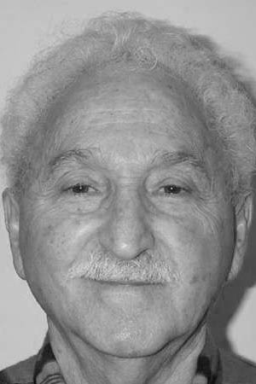
This is Mr. Jones. He has been a participant in the speech perception lab in the past. He is a 70 year old male that has now retired to Florida. His skin is soft and wrinkly and his hair is mostly white with some grey undertones. Mr. Jones is not very modern in terms of fashion or lifestyle. He likes to wear argyle sweaters or cardigans and shuffles around in wool socks and slippers. He doesn’t go out very often because he had replacement hip surgery last fall and so he is very cautious and careful whenever he walks somewhere. Mr. Jones is rather traditional and does not have internet at home. He doesn’t believe in cell phones or computers. In fact, he finds newer technology and gadgets as more of a hassle than entertainment. He does not watch much tv. He prefers to write letters by hand…..
Notes:
Audition (Script) *two people with planned responses*

Slide 35
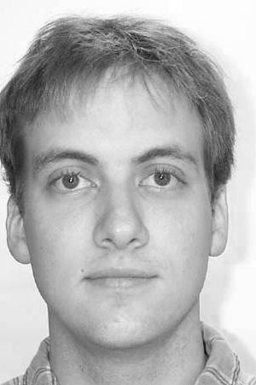
This is Tommy. Tommy has participated in our paid research studies. He is a 22 year old male that has moved from NY city. Although he was raised in NY, he has quickly adapted to Atlanta city life. Tommy is on a community rugby team for males 20-25 years of age and he plays at least once a week. Although Tommy is very athletic he does enjoy himself and likes to go out and party with his friends downtown. He prefers beer over liquor but will drink both. Tommy is very outgoing and is the first to get his group of friends pumped about doing something. For example, last spring break, Tommy coordinated a trip for him and four friends to go on a cruise to the Carribean. Tommy is always on the go and doesn’t sit around very much…..
Notes:
Audition (Script) *two people with planned responses*

Slide 36

Methodology
“chicken”
“mingle”
chicken
mingle
…..
chicken
mingle
…..
“chicken”
“mingle”
Baseline
Prime
Shadowing
Notes:
Cue graph…

Slide 37
Measuring degree of accommodation
Difference Score = Shadowed response - Baseline response
( + ) Score = shadowed response is slower than baseline
    ( - ) Score = shadowed response is faster than baseline
Baseline response
Shadowed response
ms
ms

Slide 38

Degree of Accommodation
Old Prime
Young Prime
Sidaras & Nygaard, under revision

Slide 39
Results
Social expectations influenced vocal accommodation in the absence of changes in characteristics of the acoustic speech signal (Bargh, Chen, & Burrows, 1996)
When primed with an “old” stereotype….
  Shadowed utterances were slower relative to baseline
When primed with a “young” stereotype…
  Shadowed utterances were faster relative to baseline

Slide 40
Summary
  • Short-term task-related changes in attention or expectation
  - perceptual adaptation to accented speech
  - attention and structured exposure
  • Long-term differences in listeners’ sensitivity to socially relevant variation
  - vocal adaptation
  - listener-talker attunement

Slide 41
Perceptual adaptation to informative variation
Adaptation depends on the structure of the learning environment
  short- and long-term experience
Adaptation depends on individual differences in sensitivity to
lawful variation
  social expectations and relevance to both listener and talker
Functional and representational plasticity influenced by social,
linguistic, and contextual relevance of talker variation

Slide 42
Implications
• importance of predictable variation
relationship between linguistic and nonlinguistic properties
nature of linguistic representation and processing
models of speech and language processing

Slide 43
“[T]here are no ‘neutral’ words and forms--words and forms that can belong to ‘no-one’; language has been completely taken over, shot through with intentions and accents. For any individual consciousness living in it, language is not an abstract system of normative forms but rather a concrete heterglot conception of the world. All words have a ‘taste’ of a profession, a genre…a particular person, a generation, an age group, the day and hour. Each word tastes of the contexts in which it has lived its socially charged life.”
Bakhtin (1981, page 293)

Slide 44
Acknowledgements
Emory University
Laura L. Namy, Associate Professor of Psychology
Sabrina K. Sidaras, Research Associate
Christina Y. Tzeng, Graduate Researcher
Jennifer S. Queen, Rollins College
Jessica E.D. Alexander, Concord University
The Speech and Language Laboratorey (Speech Laab)
Research supported by National Institutes of Health (NIDCD)

Slide 45
Questions
• timecourse of learning –
effects of short-, medium, and long-term experience
nested sources of variation –
  effects of variability at multiple levels

Slide 46
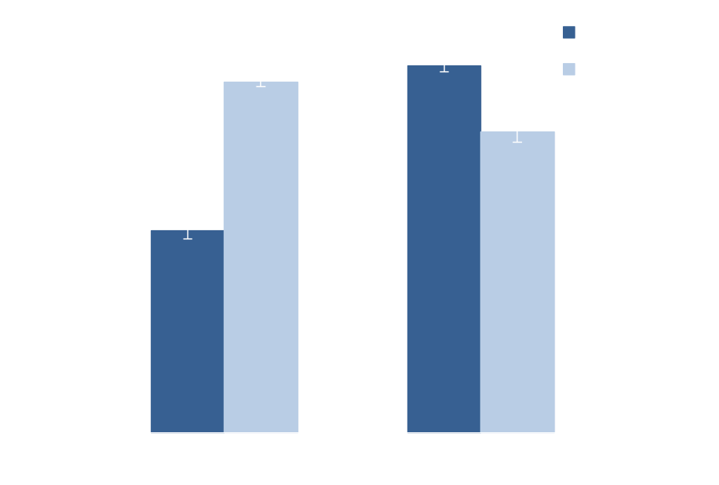
Age Judgments

Slide 47
Specificity and Generalization
Training phase
• Native English-speaking listeners trained with words….
  6 native speakers (3 male, 3 female)
Spanish-accented
Korean-accented
  Mixed accents
Albanian, Dutch, Japanese, Romanian, Bengali, Hindi,
French, German, Somali, Russian, Mandarin, Turkish
• Listeners transcribe and receive feedback
Notes:
Demographics on speakers

Slide 48
Specificity and Generalization
Generalization test
Spanish-accented words Korean-accented words
- produced by six different talkers not heard by listeners during training
  - all new words at test
- listeners transcribe without feedback
Notes:
Demographics on speakers

Slide 49
Condition Training Test
Same accent Spanish Spanish
Korean Korean
Different accent Korean Spanish
Spanish Korean
Mixed accent Mixed Spanish
Mixed Korean
No Training Spanish
Korean

Slide 50
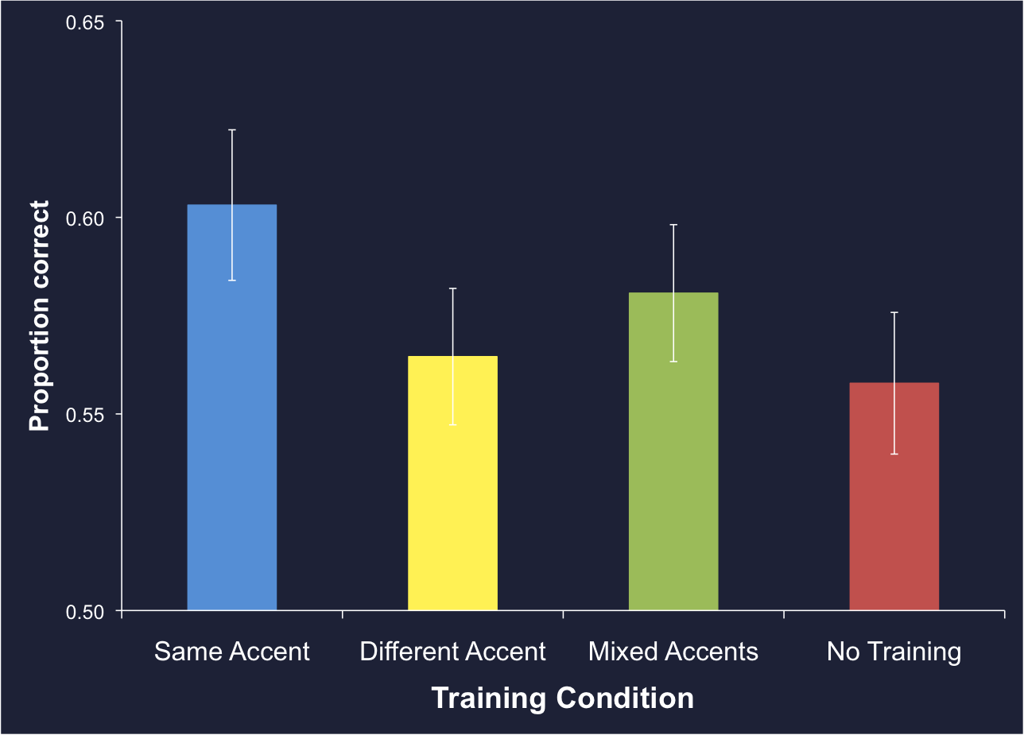
Specificity Training

